Slide 1
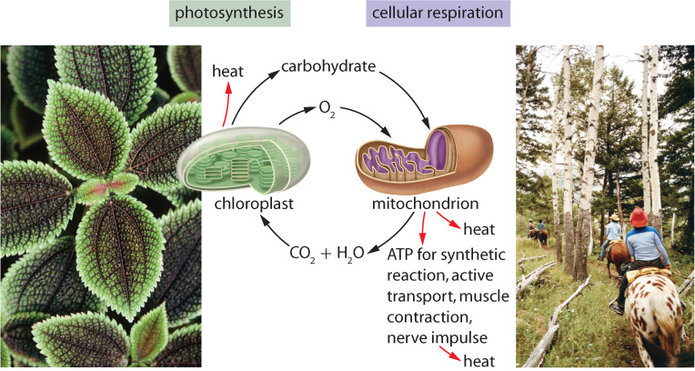
Chapter 5.1: Matter and Energy Pathways in Living Systems
Pages 162 - 168

Slide 2
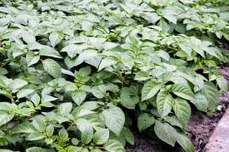

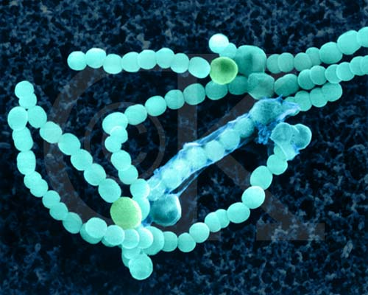
What We Already Know…
*Autotrophs can make own food
Photosynthesis (light dependent)
Chemosynthesis (light independent)

Slide 3
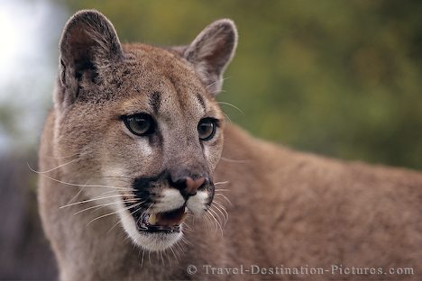
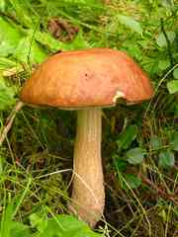
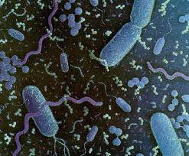
What We Already Know…
*Heterotrophs must consume autotrophs or other heterotrophs for energy

Slide 4
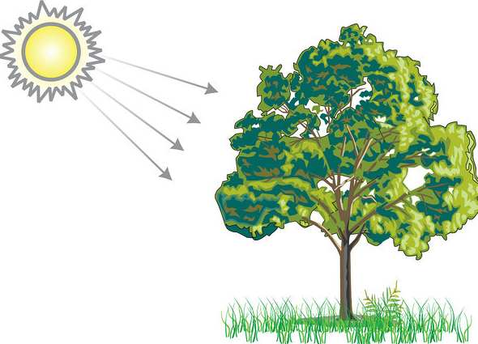
Photosynthesis:
Glucose may be converted:
_____________________
_____________________
_____________________
_____________________
_____________________

Slide 5
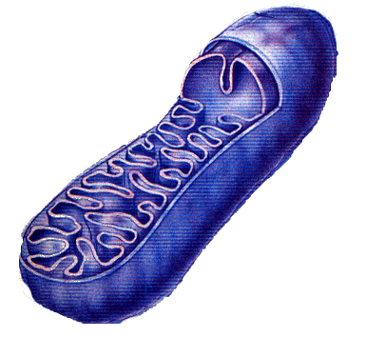
Cellular Respiration:

Slide 6
Why is Photosynthesis and Cellular Respiration Important?
Photosynthesis makes energy entering the biosphere useable:
  light → chemical
Cellular respiration builds ATP “cell currency”:
  chemical → chemical (ATP)

Slide 7
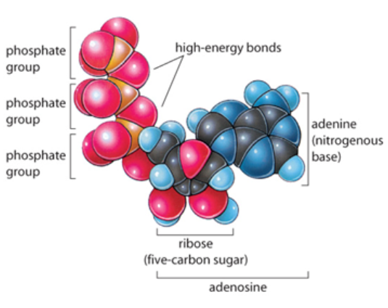
What is ATP
Adenosine Triphosphate (ATP) is molecule consisting of:
  1 adenosine group
  3 phosphates
Cell functions are powered by ATP:
  active transport
  cell division
  protein synthesis
  cell mobility
  muscle cell contractions

Slide 8
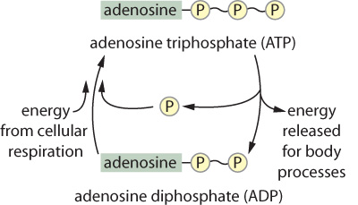
* ATP functions like a battery
* ATP must be constantly synthesized from ADP

Slide 9
ATP “shuttles” energy around the cell:
  Stores energy during the process of cellular respiration
  Brings useable energy to power cell processes
  Returns to cellular respiration as ADP and is “charged” once again

Slide 10
Energy Summary
light E →
chemical E (stored) →
chemical E (released) →
chemical E (stored) →
chemical E (released)

Slide 11
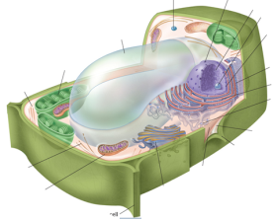
Hierarchy of Organization within Living Organisms
organelles
cells
tissues
organisms
organs
systems
The Secret Micro Universe – The Cell

Slide 12
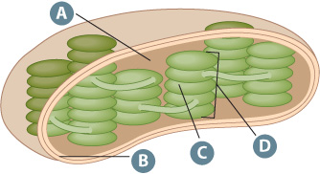
The Chloroplast
 | Structure
A
B
C
D

Slide 13
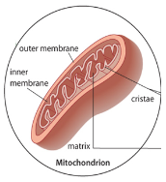
The Mitochondria
A
B
D
C
 | Structure
A
B
C
D

Slide 14
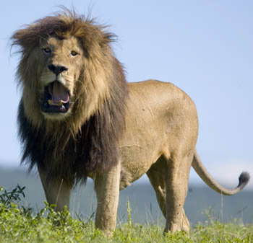
Oxidation and Reduction reactions
GER!!!
LEO

Slide 15
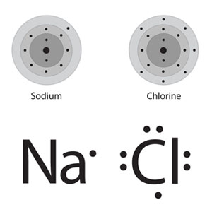
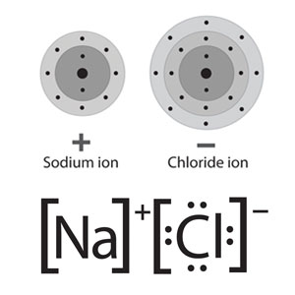
Redox Reactions
Electrons are transferred between molecules during PS and CR
For a molecule to lose an e⁻, one must gain
One reactant is oxidized (loses electrons)
One reactant is reduced (gains electrons)
Lose
Electrons
Oxidation
Gain
Electrons
Reduction
→

Slide 16
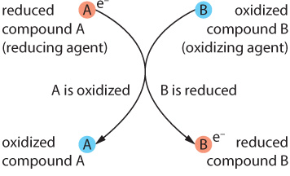
Redox Reactions
All compounds or atoms contain more energy in their reduced state.
Molecules that are in their reduced state have “reducing power”.
Glucose is in a reduced state and is energy rich.

Slide 17
Homework questions
5.1 Questions (page 168)
  #1, 2, 3 (draw a Venn diagram), 4, 5
  Due tomorrow

Slide 18
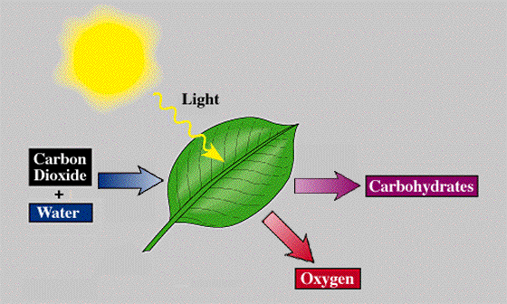
5.2 - Photosynthesis

Slide 19
Photosynthesis Re-cap
Occurs in the chloroplast
6CO₂ + 6H₂O → C₆H₁₂O₆ + 6O₂
Light E → chemical potential E (glucose)
PS stores E (endothermic)
Converts (low E) CO₂ → (high E) C₆H₁₂O₆
CO₂ is reduced (gains e⁻) to C₆H₁₂O₆
C₆H₁₂O₆ is said to have “reducing power”

Slide 20
Photosynthesis occurs in 2 stages:
  light dependent chemical reactions
    occurs in the thylakoid
  light independent chemical reactions (Calvin-Benson cycle)
    occurs in the stroma

Slide 21
Light Dependent Reactions
Occurs in the thylakoid
Light energy is captured and used to reduce ATP and NADPH
ATP and NADPH have “reducing power”
ATP and NADPH are used to power the 2nd stage of photosynthesis (light independent reactions)

Slide 22
Light Independent Reactions
Occurs in the stroma of chloroplast
ATP and NADPH from light dependent reactions used to reduce CO₂
ATP and NADPH are oxidized:
  ATP → ADP
  NADPH → NADP⁺
CO₂ is reduced:
  CO₂ → C₆H₁₂O₆

Slide 23
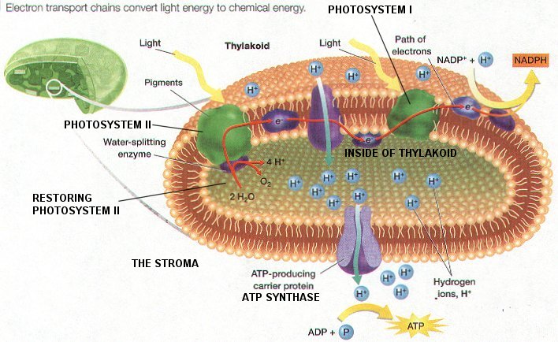
Light Dependent Reactions

Slide 24
The Thylakoid
The thylakoid membrane contains:
  clusters of photosynthetic pigment molecules
  proteins

Slide 25
Capturing Light Energy
Thylakoid membrane contains clusters of photosynthetic pigment molecules
Pigments are molecules that absorb certain wavelengths of light
Our “perceived color” is the wavelength that is reflected (not absorbed):
  chlorophyll a (blue-green)
  chlorophyll b (yellow-green)
  carotenoids (yellow, orange, red)

Slide 26
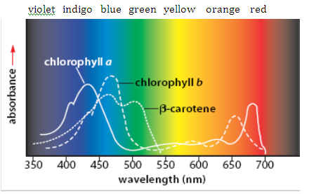
How do we know what color of light is reflected or absorbed by a pigment molecule?

Slide 27
What is the advantage to a plant having more than one pigment?

Slide 28
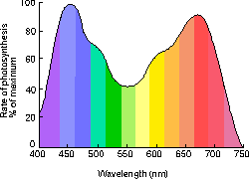
Based on the Action spectrum above, which are the best colors of light to absorb for maximum photosynthesis?

Slide 29
How can measuring the oxygen production rate of a plant be used as an indirect way of measuring the rate of photosynthesis?

Slide 30
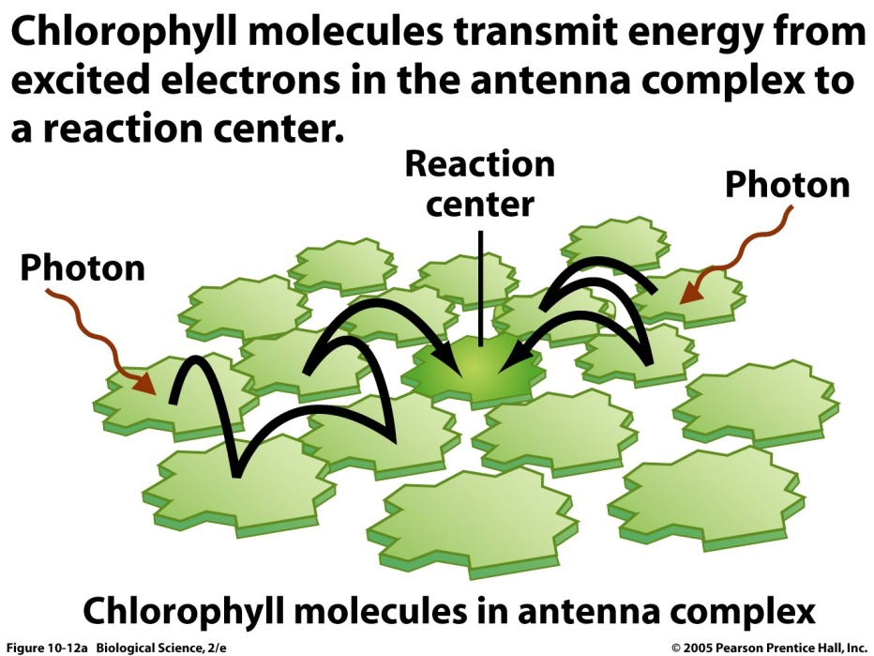
Clusters of photosynthetic pigment molecules in thylakoid membrane called photosystems capture light energy
A photosystem contains:
  12+ chlorophyll b (pass e- to reaction centre)
  1 chlorophyll a (reaction centre)
  a few carotenoid (accessory pigments)

Slide 31
Photosystems II and I
Named for order of discovery, not sequence in light-dependent reactions

Slide 32
Q5. What is a photosystem?
Q6. What molecules are present in a photosystem?

Slide 33
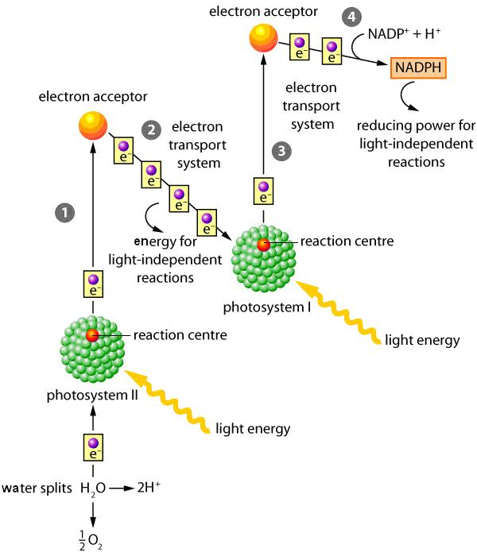
Light-dependent Reactions Overview

Slide 34
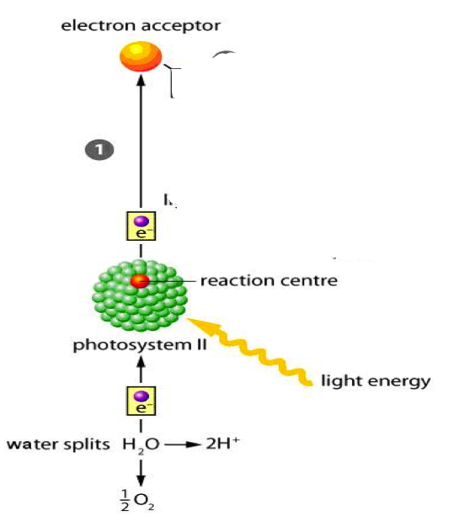
1) Electron in PSII reaction centre is passed to acceptor; electron is replenished by the photolysis (splitting of water). Oxygen is released from plant, H⁺ remains in stroma.

Slide 35
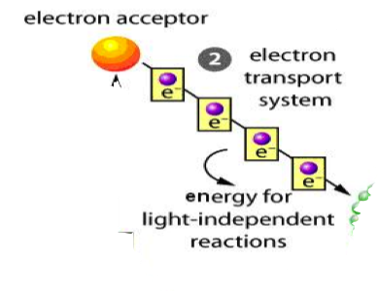
2) Electron is passed along electron transport system (ETS). Energy released is used to pump H⁺ from stroma into thylakoid space (creating a concentration gradient). Concentration gradient will be used to produce ATP during chemiosmosis.

Slide 37
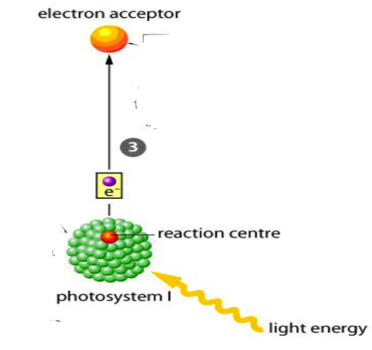
3) Low energy electron from PSII is excited in PSI. Electron is passed to acceptor.

Slide 39
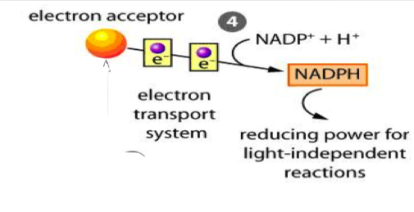
4) Electron is passed along electron transport system (ETS). NADP+ is reduced (gains e⁻) to NADPH. NADPH has “reducing power”. NADPH will be used in Calvin-Benson Cycle.

Slide 41
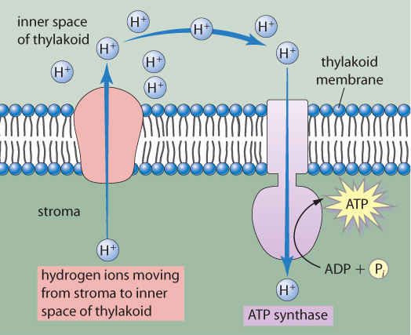
*Chemiosmosis
H⁺ are pumped across the thylakoid membrane from the stroma using energy from ETS.
H⁺ cannot diffuse back because of charge. A concentration gradient is produced
H⁺ may only pass down concentration gradient via ATP synthase protein. As H⁺ passes through ATP synthase, ATP is regenerated from ADP. ATP will be used in light-independent reactions (Calvin-Benson Cycle)
2
1
3

Slide 43
Light-Independent Reactions
(The Calvin-Benson Cycle)
Occurs in the stroma of the chloroplast
Powered by ATP and NADPH produced during light reactions
CO₂ (low E) is reduced to glucose (high E)
Final product is glucose

Slide 44
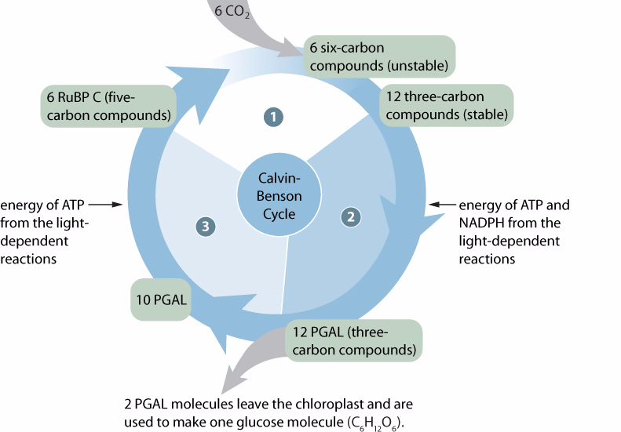

Slide 45
Carbon dioxide fixation: carbon dioxide is bonded to RuBP (ribulose biphosphate) but is unstable. Is immediately converted into a stable 3-carbon compound.
Reduction: 3-carbon compound is reduced by ATP and NADPH from light reactions. 3-carbon compound forms PGAL (high energy compound).
2 PGAL leave cycle to make glucose, 10 PGAL are used to make more RuBP to pick up more carbon dioxide. The cycle repeats.

Slide 46
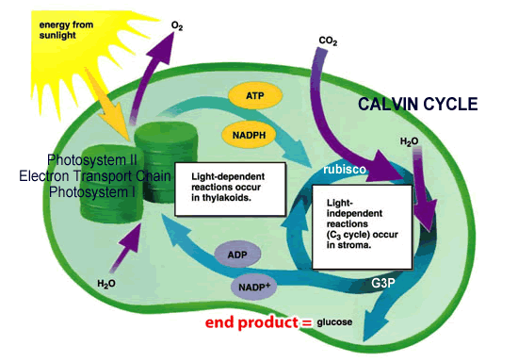

Slide 47
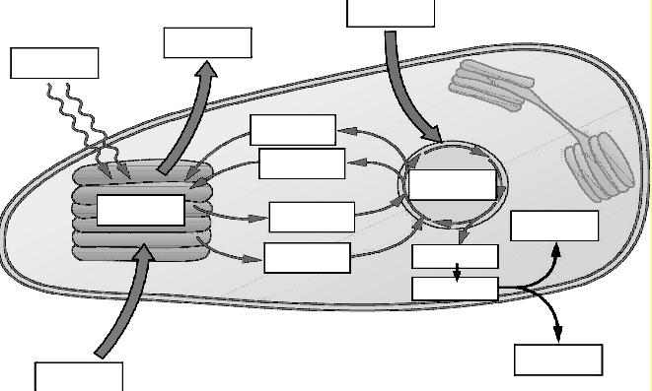
Label the diagram below with the following terms: O₂, CO₂, ADP, ATP, NADP, NADPH, PGAL, thylakoid, stroma, starch, glucose, water, lipids, light energy

Slide 48
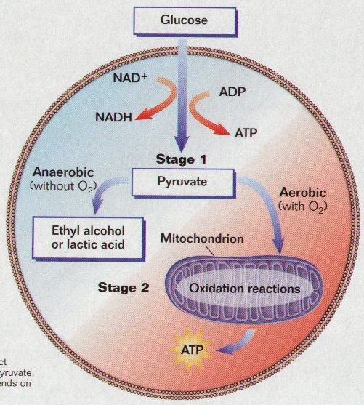
Chapter 5.3 – Cellular Respiration (Pages 182–195)

Slide 49
In this section, you will
distinguish among aerobic respiration, anaerobic respiration, and fermentation
explain how carbohydrates are oxidized by glycolysis and the Krebs cycle to produce NADH, FADH₂, and ATP
explain how chemiosmosis converts the reducing power of NADH and FADH₂ to the chemical potential of ATP

Slide 50
Cellular Respiration Re-cap
Occurs in the mitochondria
C₆H₁₂O₆ + 6O₂ → 6CO₂ + 6H₂O
chemical potential E (glucose) → ATP
CR releases E (exothermic)
C₆H₁₂O₆ is oxidized (loses e⁻) to CO₂
ATP is the final product

Slide 51
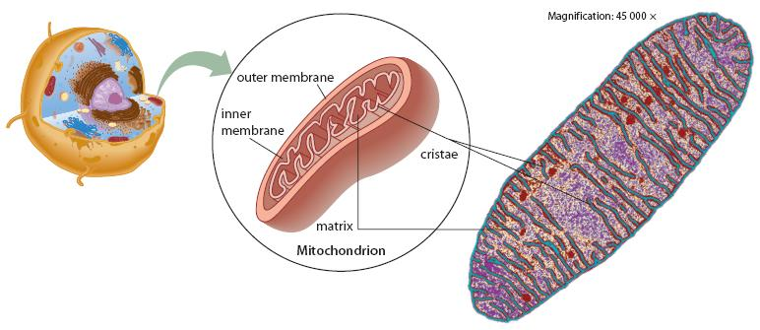
Mitochondria Structure Review!

Slide 52
CELLULAR RESPIRATION PATHS
Aerobic (O₂ present)
Process of glycolysis
Krebs prep
Krebs cycle
Electron transport chain and chemiosmosis
Anaerobic (No O₂ present)
Process of glycolysis
Fermentation
  lactic acid
  ethyl alcohol

Slide 53
Aerobic vs. Anaerobic Respiration
Aerobic
Anaerobic
Oxygen present
Mitochondria
Glycolysis → Krebs prep → Krebs cycle → ETS and chemiosmosis
Slow process
Produces 36 ATP molecules
No oxygen present
Cytoplasm
Glycolysis → Fermentation
Fast process
Net gain of 2 ATP

Slide 54
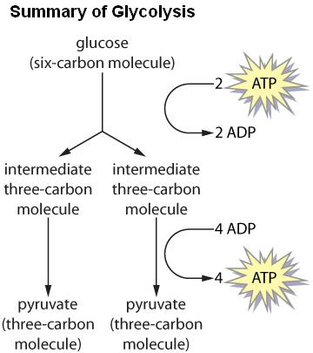
GLYCOLYSIS
Occurs in cytoplasm
Anaerobic process
1 glucose molecule is broken into 2 pyruvate molecules
Requires 2 ATP
Products:
  2 pyruvate molecules
  2 NADH (reduced)
  4 ATP (net gain of 2 ATP)

Slide 55
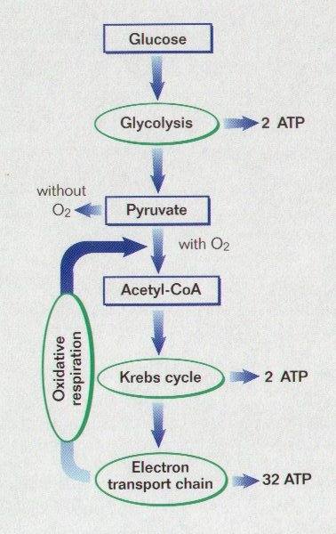
AEROBIC RESPIRATION
KREBS PREP:
2 pyruvate (3C) in cytoplasm are picked up by coenzyme A (CoA)
Loses 1 carbon (CO₂) to form acetyl CoA (2C)
2 NAD⁺ reduced to NADH in process

Slide 56
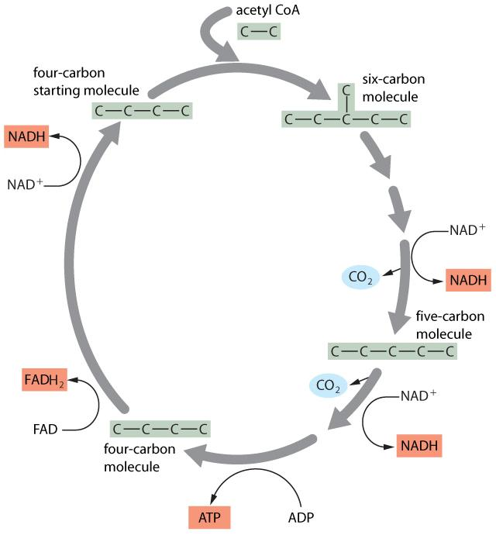
KREBS CYCLE:
Occurs in matrix of mitochondria
4C starting molecule picks up 2C from acetyl CoA to form a 6C molecule
6C is oxidized twice (lose C as CO₂) to reform 4C starting molecule
Reduced:
  NAD⁺ → NADH
  FAD → FADH₂
  ADP → ATP

Slide 57
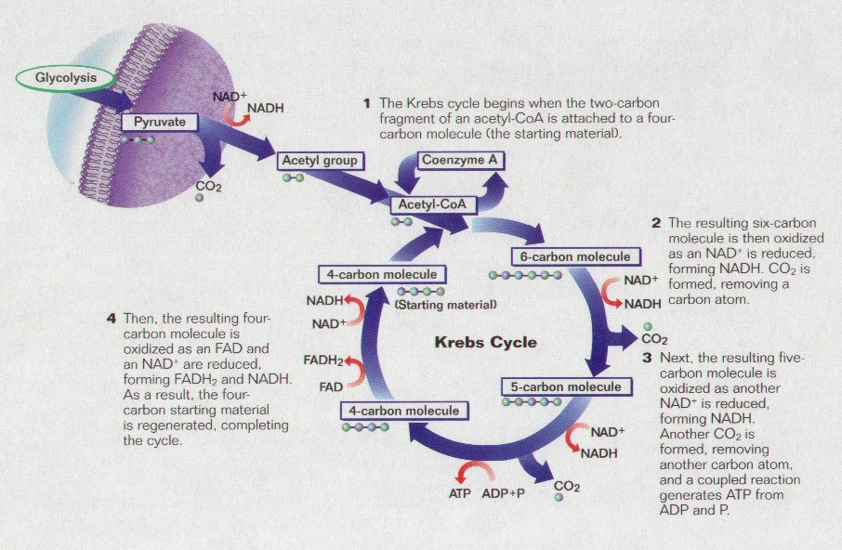
KREBS CYCLE SUMMARY

Slide 58
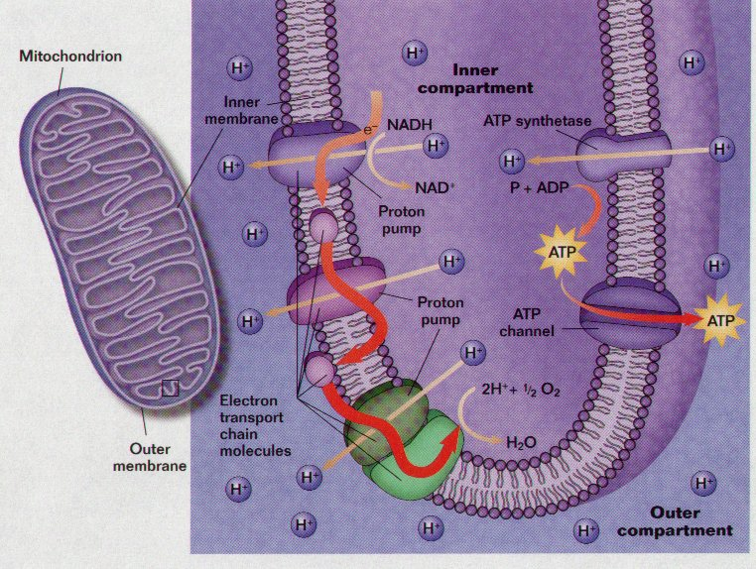
ELECTRON TRANSPORT SYSTEM
NADH, FADH₂ shuttle e- to electron transport system in inner membrane of mitochondria
e- are passed through series of molecules
energy released during process used to pump H+ into intermembrane space

Slide 59
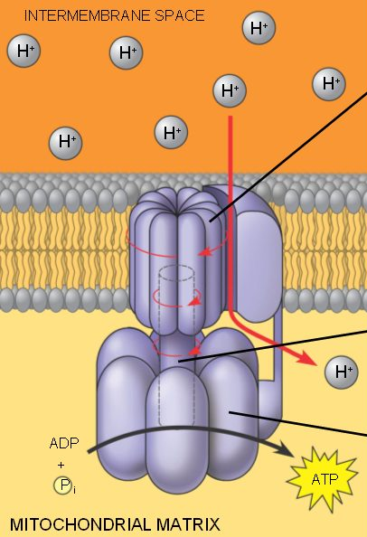
CHEMIOSMOSIS:
H⁺ concentration gradient created in intermembrane space
H⁺ must pass through ATP synthase to move down concentration gradient (ADP + P → ATP)
High ATP output
Oxygen is final acceptor for H⁺ and e⁻ (produces H₂0)
Electron Transport Chain and Chemiosmosis

Slide 60
What does the oxygen do?
The oxygen is the final electron acceptor at the end of the electron transport system
Oxygen “picks-up” 2 e⁻ and 2 H⁺ to form H₂O
If there were a shortage of oxygen to pick-up the electrons at the end of the ETS; ETS and Krebs cycle would become “backed-up” with e⁻ and H⁺.
Krebs cycle and the ETS would stop functioning, ATP would only be produced by glycolysis.
What happens when you run out of oxygen?

Slide 61
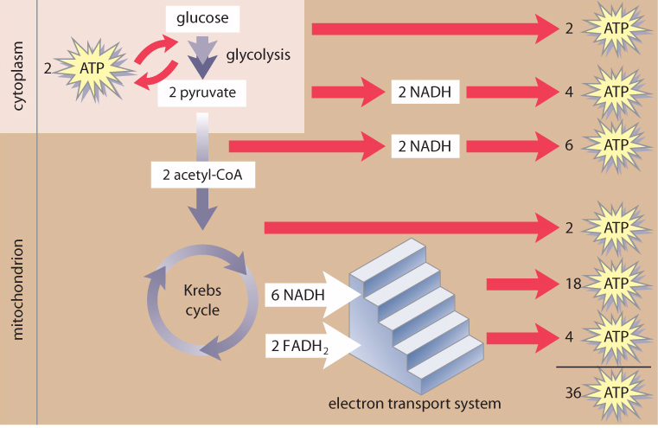
Summary of ATP Production
Small amount of ATP is generated by glycolysis
Small amount of ATP is generated by the Krebs cycle
The majority of the ATP is generated by chemiosmosis using energy generated via the electron transport system

Slide 62
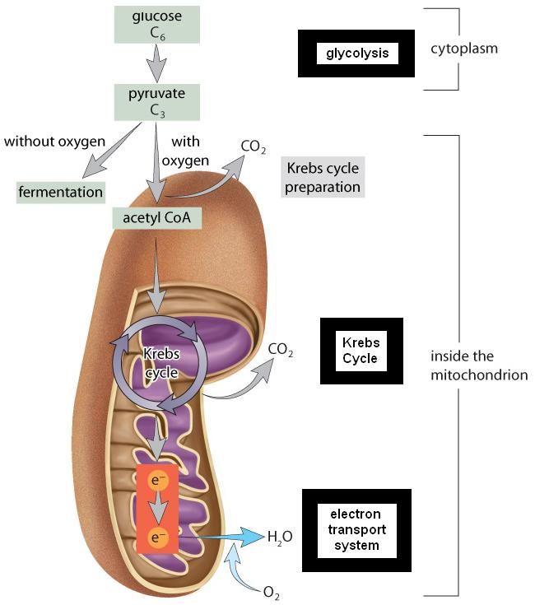

Slide 63
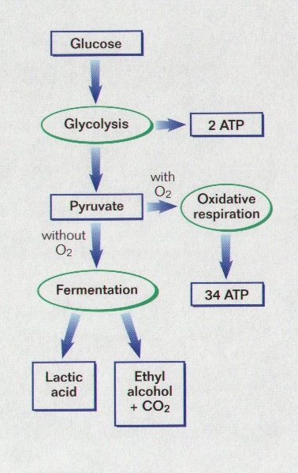
ANAEROBIC RESPIRATION
Organisms living in anaerobic environments must use a different e- acceptor than oxygen
Anaerobic respiration begins with glycolysis
Fermentation process reduces pyruvate
Lactic acid or ethyl alcohol produced

Slide 64
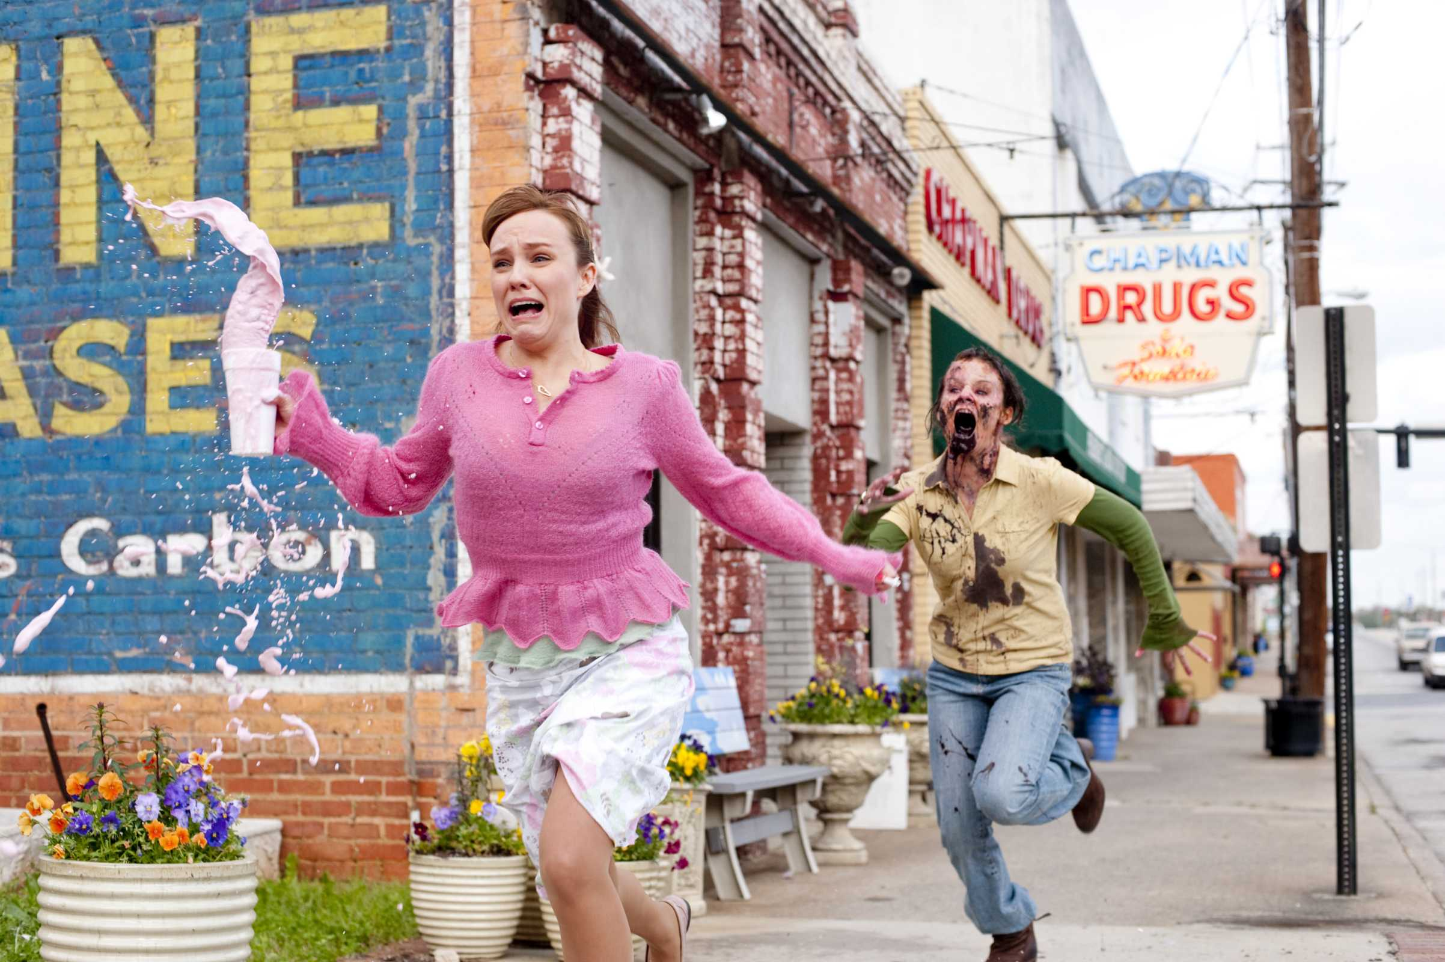
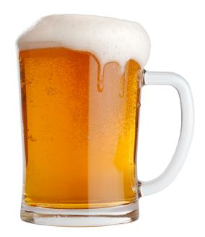
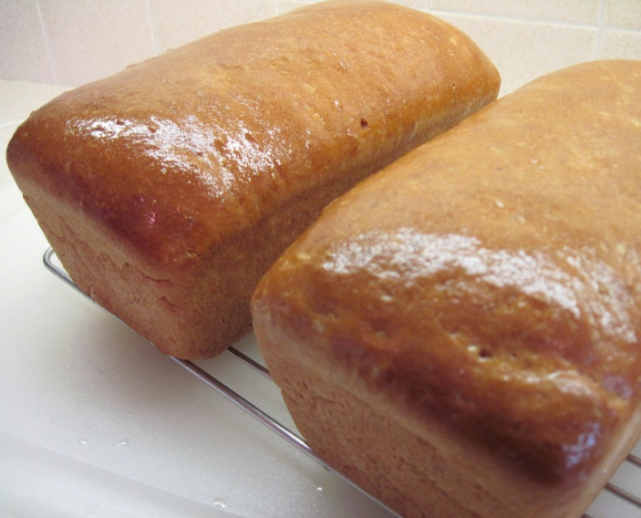
FERMENTATION:
Metabolic pathway that includes glycolysis and one or two reactions that oxidize NADH to NAD+
Less efficient at supplying energy than aerobic respiration; only 2ATP from glycolysis are produced
Two common types: lactate and ethanol fermentation

Slide 65
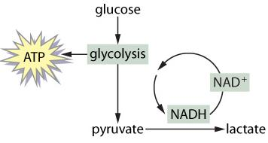
Lactate Fermentation
In muscle that is functioning anaerobically, pyruvate is converted to lactate and the reduced NADH is re-oxidized so that glycolysis can continue.

Slide 66
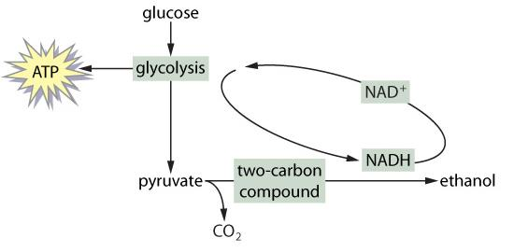
Ethanol Fermentation
In yeast growing anaerobically, pyruvate is converted to carbon dioxide and ethanol

Slide 67
Ethanol fermentation by “brewer’s yeast” is used in industry to produce baked goods and alcoholic beverages
Other organisms can yield other substances besides lactate and ethanol

Slide 68
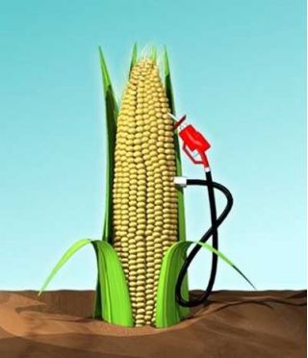
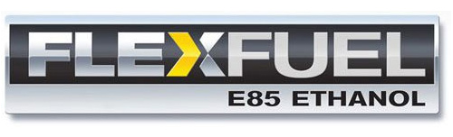
Fermentation is used on an industrial scale to produce ethanol
Ethanol is used as an additive to gasoline to reduce some environmental contaminants

Slide 69
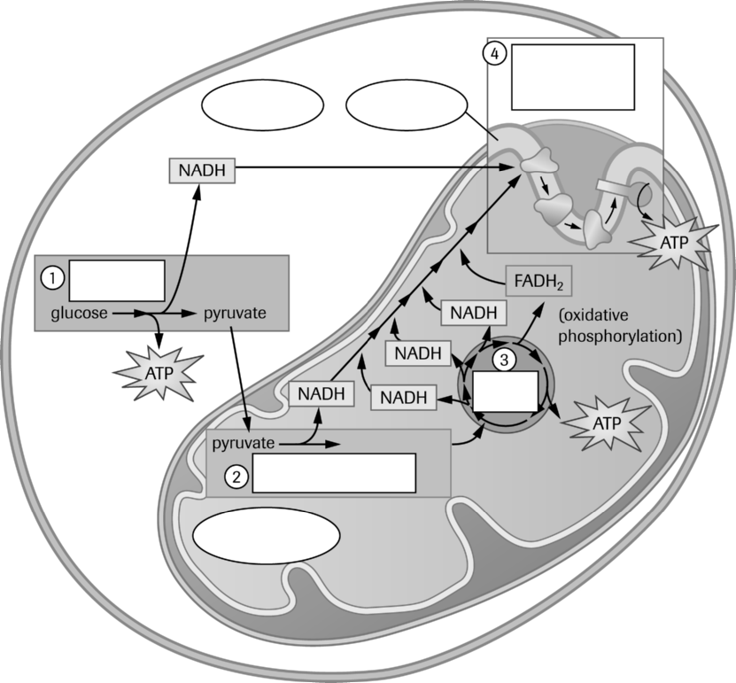
Name the four stages of aerobic respiration and identify where they occur within the cell:
Stage 1:
Stage 2:
Stage 3:
Stage 4:
Fill in the missing labels in this overview diagram of aerobic respiration.

Slide 70

Summary Aerobic Respiration

