Slide 2
1
Where do living things get energy?

Slide 3
2
List the 3 types of organic molecules found in food.

Slide 4
3
Define autotroph.

Slide 5
4
Producers or autotrophs make their own food be converting energy from the ___ into chemical energy in the form of ___ compounds.

Slide 7
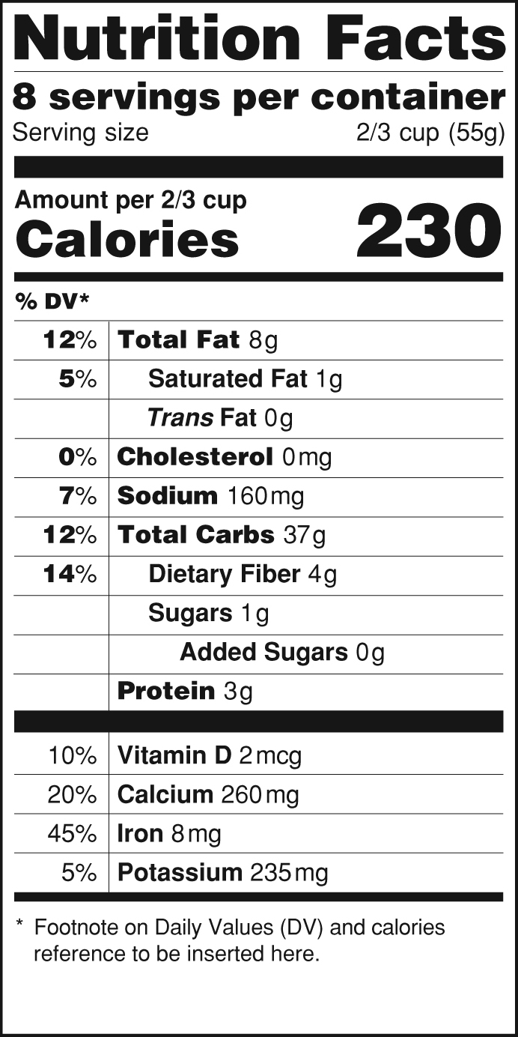
6
What unit is used to measure
the energy in food?
Notes:
Image is public domain.

Slide 8
7
Cellular respiration converts chemical energy stored in organic molecules into chemical energy the cells can use called ___.

Slide 9
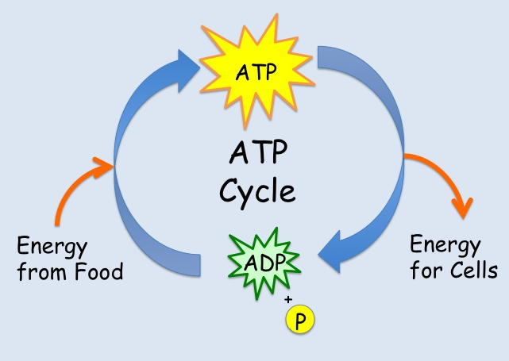
8
Fill in the blanks on this diagram
showing the flow of energy through
the ATP cycle.
Energy from
___
Energy for
___

Slide 11
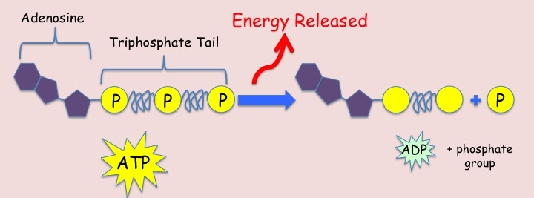
10
An ATP molecule stores ___ energy, which is released when a ___ group is pulled away during a chemical reaction.

Slide 12
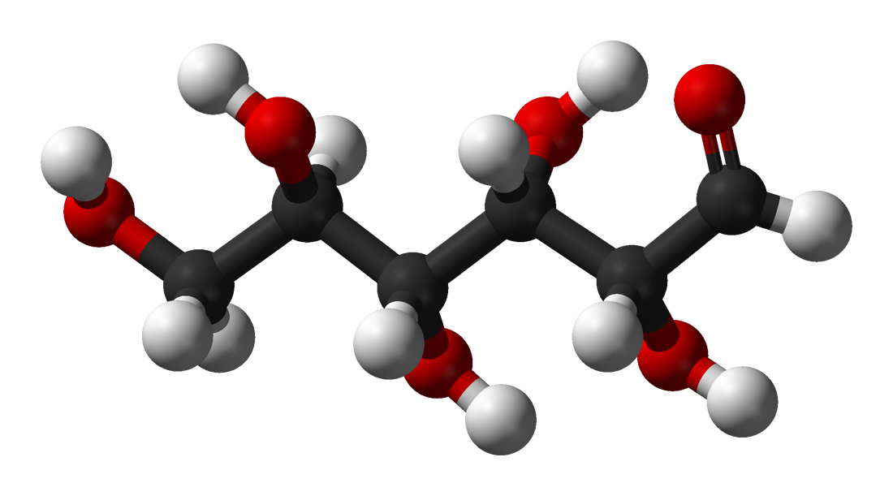
11
___ is the most common and preferred energy source for cells.

Slide 13
12
Briefly explain this diagram.
Sunlight
Glucose
ATP

Slide 14
13
Write the word equation for cellular respiration.

Slide 15
14
Complete the overall chemical equation for cellular respiration.
6 ___ + 6 O₂ → 6 CO₂ + 6 ___
+
ATP

Slide 16
The products of cellular respiration are the ___ of photosynthesis and the ___ of photosynthesis are the ___ of cellular respiration.
15
Cellular Respiration
Photosynthesis

Slide 17
16
A process that requires oxygen is ___ and a process that does not require oxygen is ___.

Slide 18
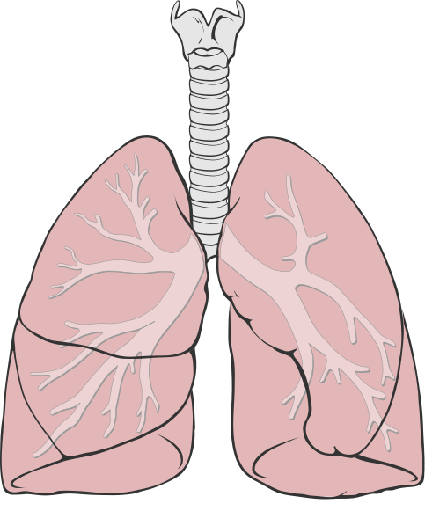
17
Breathing supports
cellular respiration by
providing the body with ___
and removing
___ ___.

Slide 20
19
List the products of
glycolysis.

Slide 21
20
Explain the net production of ATP in glycolysis.

Slide 22
21
Briefly describe what happens in the intermediate or transition reaction that occurs between glycolysis and the Krebs Cycle.
Glycolysis
?
Krebs Cycle

Slide 23
23
The ___ ___ occurs only when oxygen is present, but does not directly require oxygen.

Slide 25
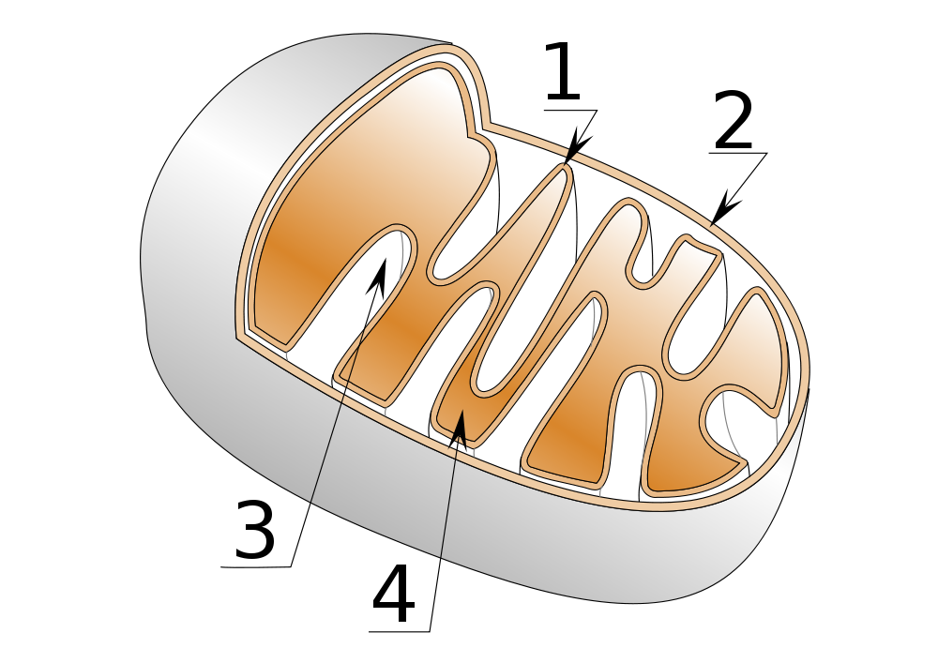
24
Identify the parts of a mitochondrion?

Slide 26
25
Name the two molecules that carry electrons to the electron transport chain.

Slide 27
26
Match the stage of Cellular Respiration to the location where it occurs.
Glycolysis a. inner mitochondrial membrane
Krebs Cycle b. cytoplasm
ETC & ATP c. mitochondrial matrix synthase action

Slide 28
27
Falling electrons are the energy source for generating ___. Electrons “fall” from ___ towards oxygen.
e⁻

Slide 29
28
The electron transport chain releases energy that is used to pump ___ ___ across the inner mitochondrial membrane.

Slide 32
31
How many ATP molecules are produced in each stage of Cellular Respiration?
Glycolysis: __
Krebs Cycle: __
ETC & ATP Synthase Action: __

Slide 33
32
Define fermentation.

Slide 34
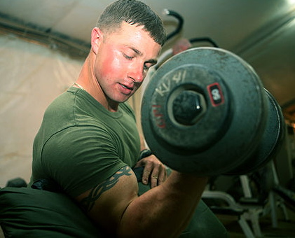
33
What causes muscle soreness?

Slide 35
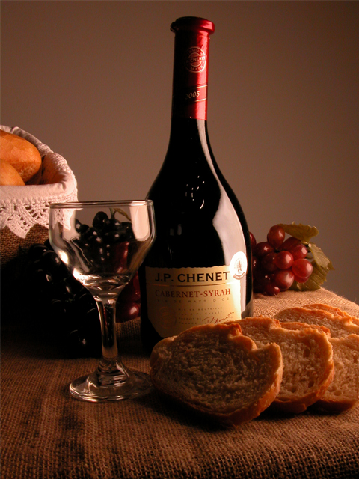
34
Fermentation in yeast produces ___ and ___.

Slide 36
35
Compare the ATP production from cellular respiration to that of fermentation.

Slide 37
Blank Cards in Matching Format
Add more by inserting duplicate slides.

